Slide 1

UCLQ Quantum Energy Hackathon
Team Quantumlatinoπ
Giancarlo Salirrosas Martínez
Henry Atkins
Mauro Mendizabal Pico
Thomas R. Clarke

Slide 2
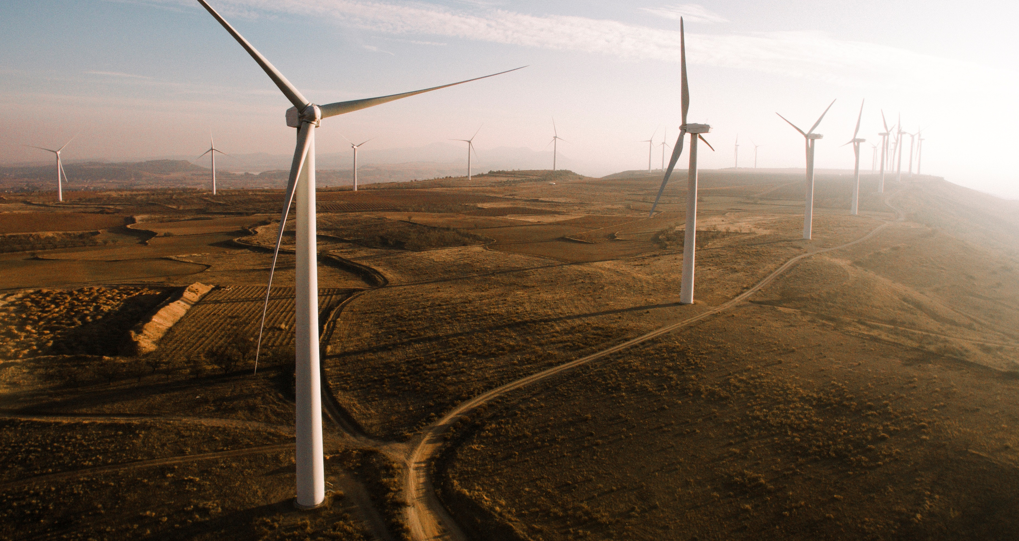
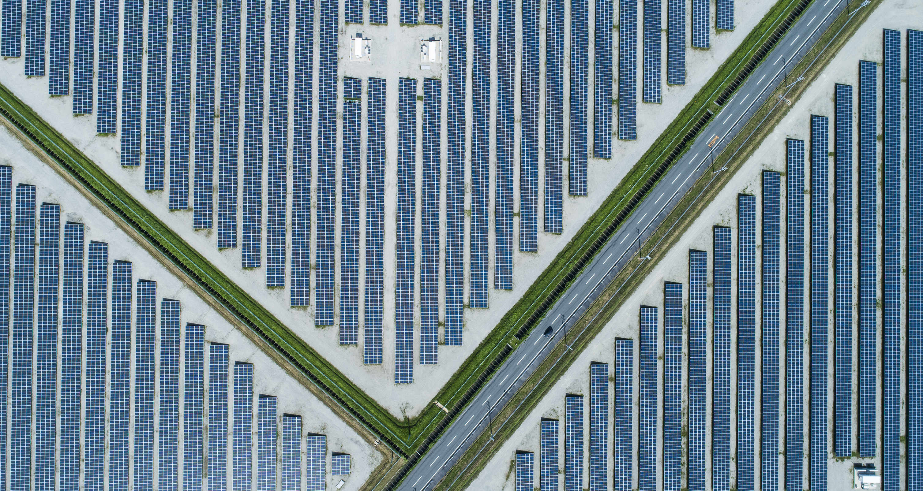
Introduction
Decarbonising the national grid in an economical way presents a complex optimisation problem [1]
Providing just enough power to meet demand whilst minimising cost and waste & considering environmental factors is challenging [2]
We explore how Noisy Intermediate Stage Quantum (NISQ) algorithms can be used to solve a simplified toy model of this problem
We implement the Quantum Approximate Optimisation Algorithm (QAOA)
Eskandarpour R, Gokhale P, Khodaei A, et al., 2020 Quantum Computing for Enhancing Grid Security
Ajagekar A, You F, 2019 Quantum computing for energy systems optimization: Challenges and opportunities

Slide 3

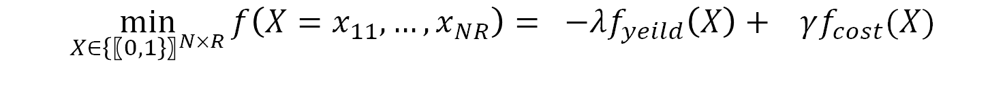
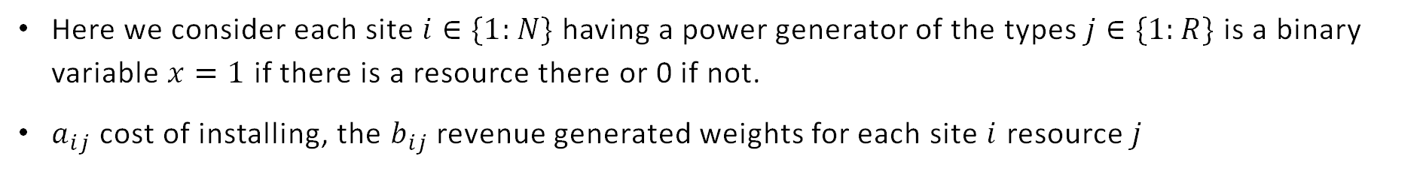
Problem Formulation
This optimisation problem can be formulated as minimising an objective function that maximises the energy output whilst minimising the total costs
$$\min_{X∈{\{〖0,1\}〗}^{N×R}}{f\left(X=x_{11},…,x_{NR}\right)}= −λf_{yeild}\left(X\right)+ γf_{cost}(X)$$
$$\sum_{i,j}^{N,R}{a_{ij}}x_{ij} \sum_{i,j}^{N,R}{b_{ij}}x_{ij}$$
Here we consider each site $i$ $∈\{1:N\}$ having a power generator of the types $j∈\{1:R\}$ is a binary variable $x=1$ if there is a resource there or 0 if not.
$a_{ij}$ cost of installing, the $b_{ij}$ revenue generated weights for each site $i$ resource $j$

Slide 4
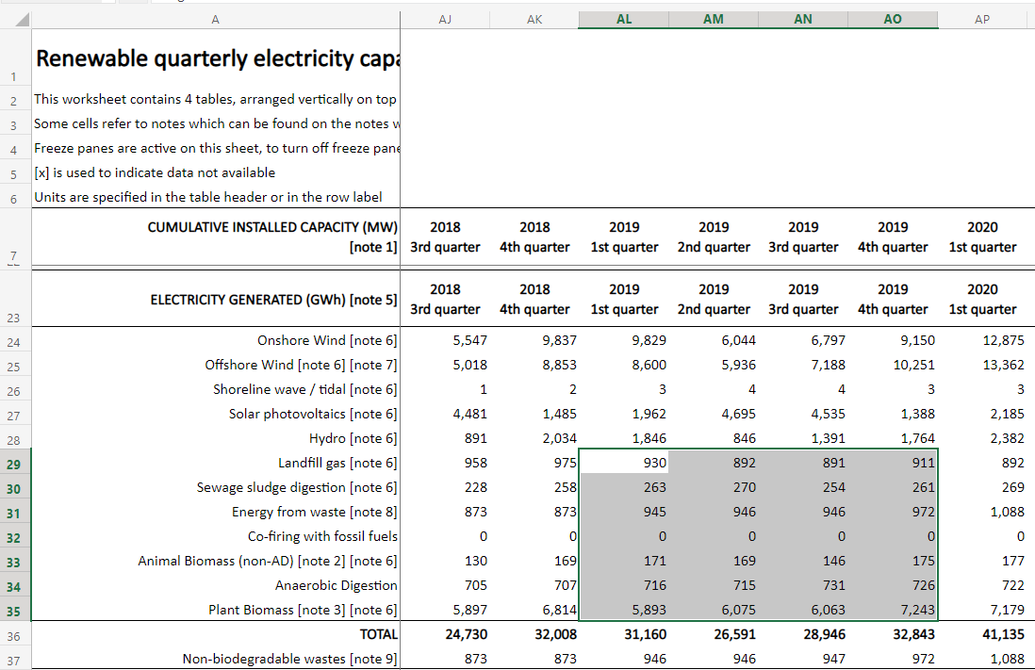
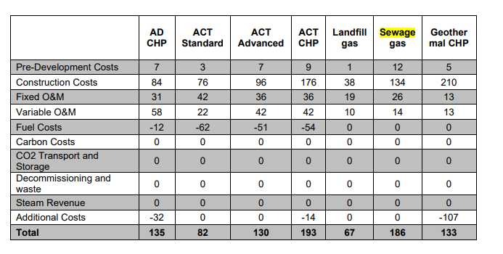
Data Extraction
Data was extracted from the National Statistics publication of Energy Trends.
The data input into code cells in the - One additional energy source input (New code) - header in the .ipynb file.
The Renewable Quarterly Electricity Capacity associated with each category is displayed and we use quarterly values for 2019 in the model.
Notes:
We found additional data sources to

Slide 5
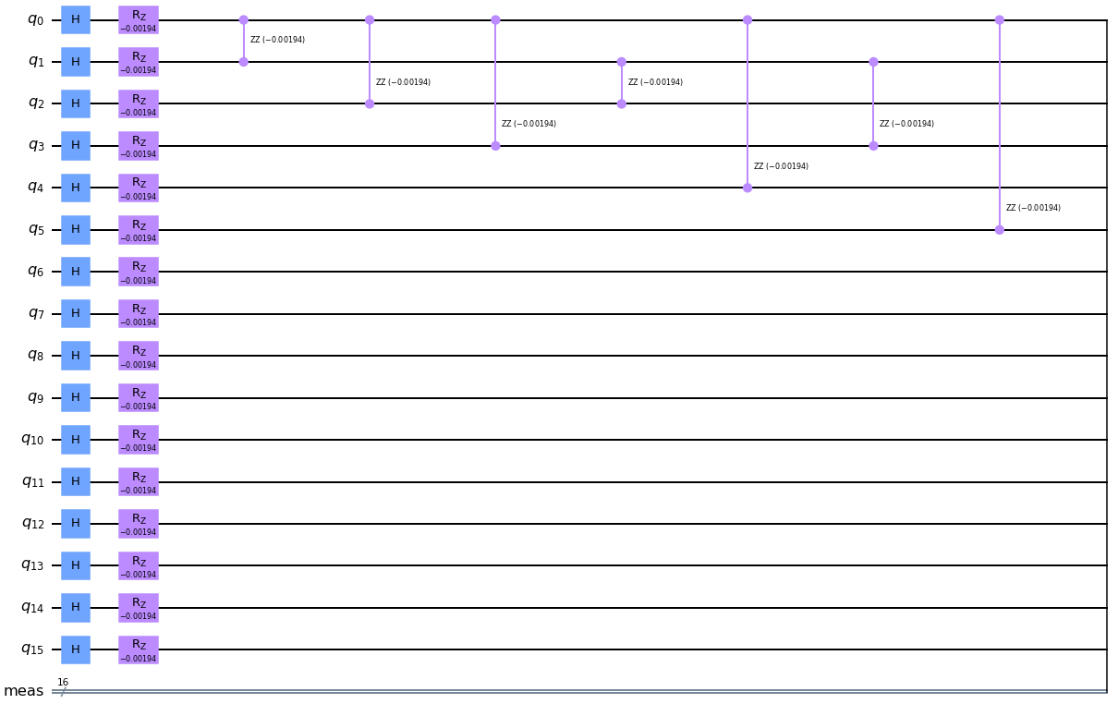
Quantum Circuit
First apply Hadamard gates to entangle all the qubits.
Then we apply RZ rotations to each. The phase is optimized via QAOA optimisation.
Please see the README file for more in--depth architecture images.

Slide 6
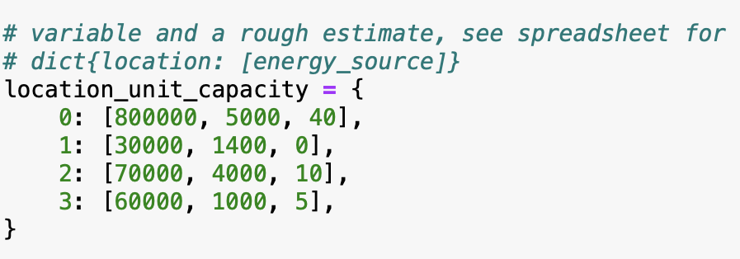
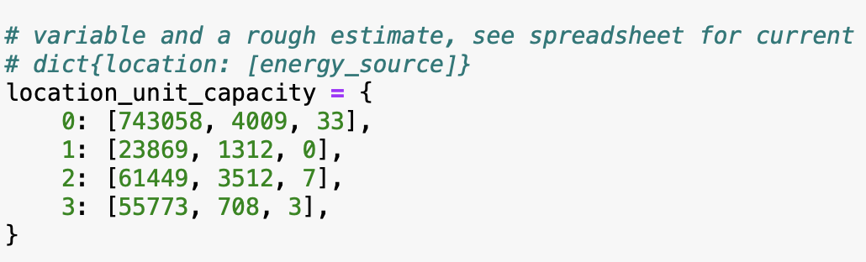
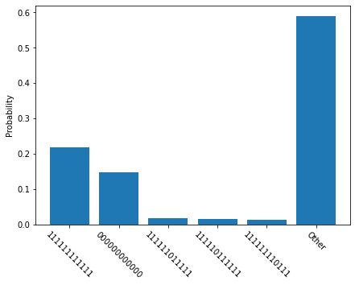
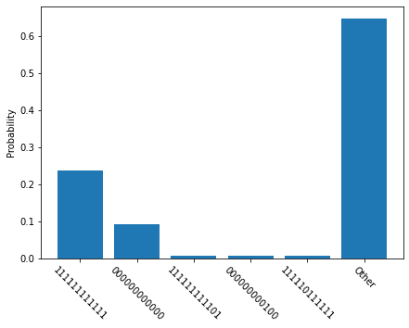
3. Impact on output
In this section, we’ve found that initial inputs on the capacity were different than the spreadsheet. We changed the inputs in order to see the final impact on the output of the model:
Notes:
We found additional data sources to

Slide 7
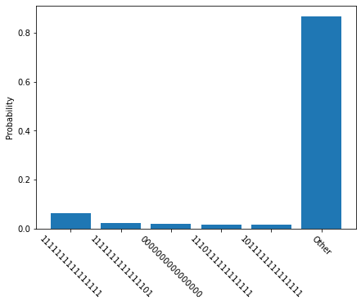
3. Impact on output
In this section, we’ve changed the number of shots from 512 to 1012
05 inputs
03 inputs
1012 shots
1012 shots
Notes:
We found additional data sources to

Slide 8
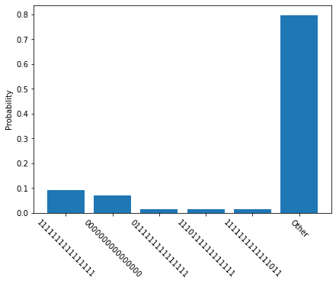
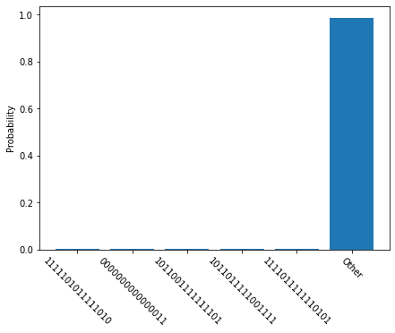
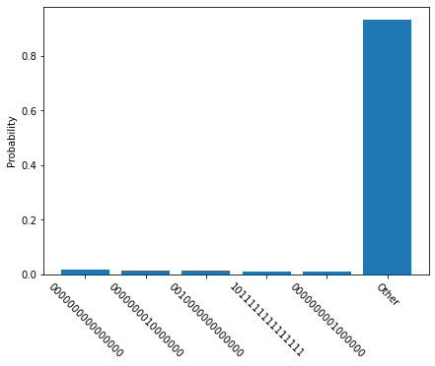
4. Classical Optimization Methods
We have tried different classical optimization methods for the model:
Nelder-Mead
Powell
CG
trust-constr
BFGS
L-BFGS-B
TNC
COBYLA
Notes:
The results were more or less the same for all

Slide 9
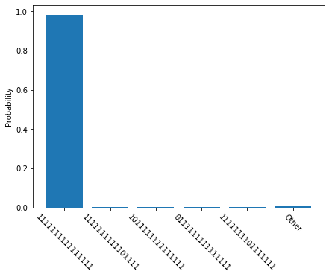
Results
COBYLA with the modified QAOA
The bit string tells us where we should place our power stations and which type
Very high probability of all 1 is similar to the behaviour of an Ising Spin model at low T [3,4]
This result suggests all power stations at all locations should be built- an invalid result
3. Clarke T. R. , 2021 Monte Carlo Simulation of Ferromagnetic Phase Transitions
4. Uzunoff A et al 2021, Critical Phenomena in the Classical Ising Model

Slide 10
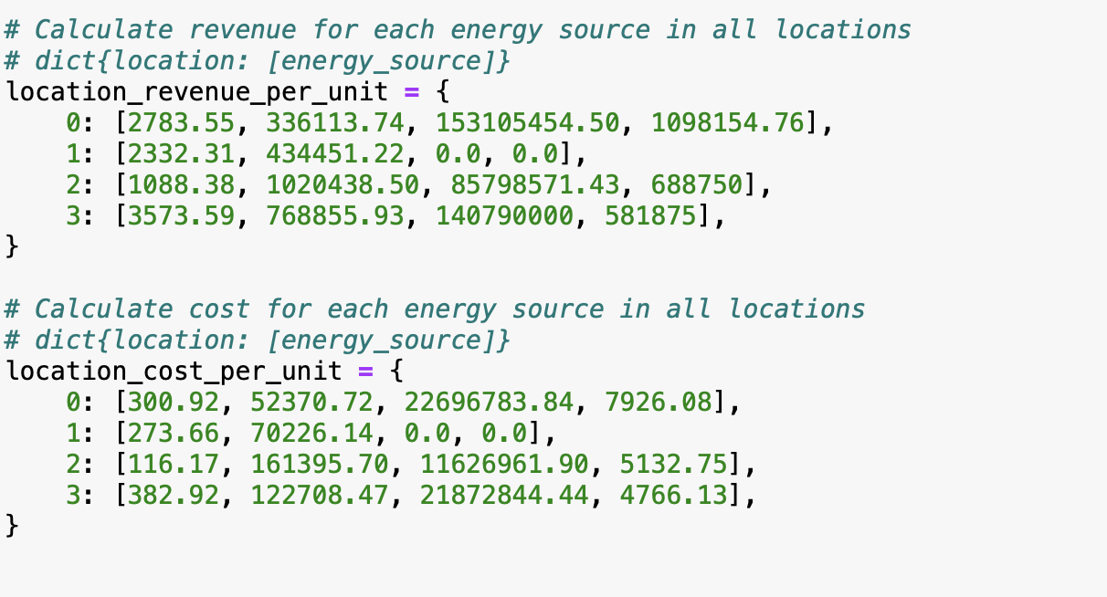
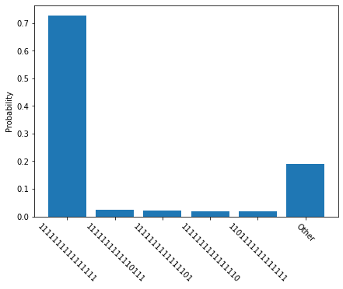
Stress Analysis
So far we have not taken into account volatility in prices
In recent years the UK has seen significant inflation in energy prices
The current war in Ukraine has sent gas prices 45% higher [5]
To predict how our model responds to sudden price pressures we’ve performed a stress analysis
A +15% delta caused a >20% drop in all probabilities except the all 1 solution
5. The Guardian, 2022 Oil jumps to $105, gas prices surge and global stocks tumble after Ukraine invasion – as it happened

Slide 11
Conclusions
QAOA doesn’t guarantee the results obtained (even on a simulator) are a good solution to the problem
Adding an additional energy resource didn’t impact the final result in a statistically significant way
For this small scale problem, a manual solution could be more practical
Stress analysis showed higher prices skewed distribution more to all 1 solution
This project doesn’t show how quantum advantage could be obtained using this problem formulation on a classical simulator

Slide 12
Extensions of this work
The model could be improved:
Learning Rate for the cost of each energy source as a function of existing capacity
Additional energy resources (geothermal, nuclear)
Regional cost differences in building power stations
Alternative models to explore, QUBO/VQE [3]
Use of Quantum Monte Carlo methods [4]
Adding time dependence for seasonal variations in renewables/energy prices
Lucas A 2013 Ising formulations of many NP problems
S. Herbert 2021, Quantum Monte-Carlo Integration: The Full Advantage in Minimal Circuit Depth

